Slide 1
Arduino CommShell

Slide 2
What is Arduino CommShell
An interactive command executive environment
Running on ANY Arduino platform
Designed for teachers to demonstrate mechatronic system principles
A framework for Arduino software developers

Slide 3
Review of existing Arduino shell software
Bitlash
in the form of Library
AVRsh
Unix-like shell, a new firmware.
Arsh
Very basic
MicroBox
Programmed in C/C++

Slide 4
Features of Arduino Shell
Portable
Easy of use
Highly customizable

Slide 5

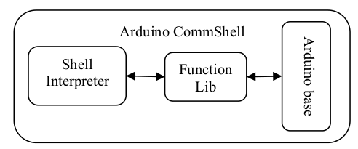
How Arudino Shell works
Structure of the system
Architecture

Slide 6
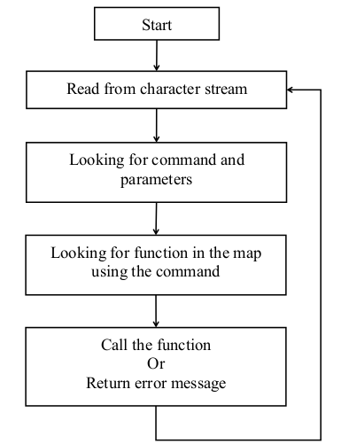
Working process of Arduino Shell
a shell waiting for command
mapping command to functoion
call the function
return with message

Slide 7
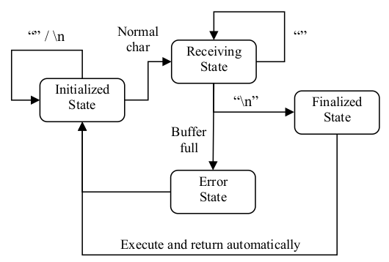

Design of the shell interpreter
Protocol of the serial communication
State machine to analize the character stream

Slide 8

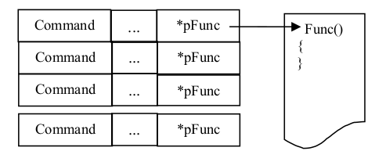
How to locate the function in function library
Define the interface for function
Data structure of function library

Slide 9
Implementation

